Slide 1
House Loan Eligibility Prediction

Slide 2
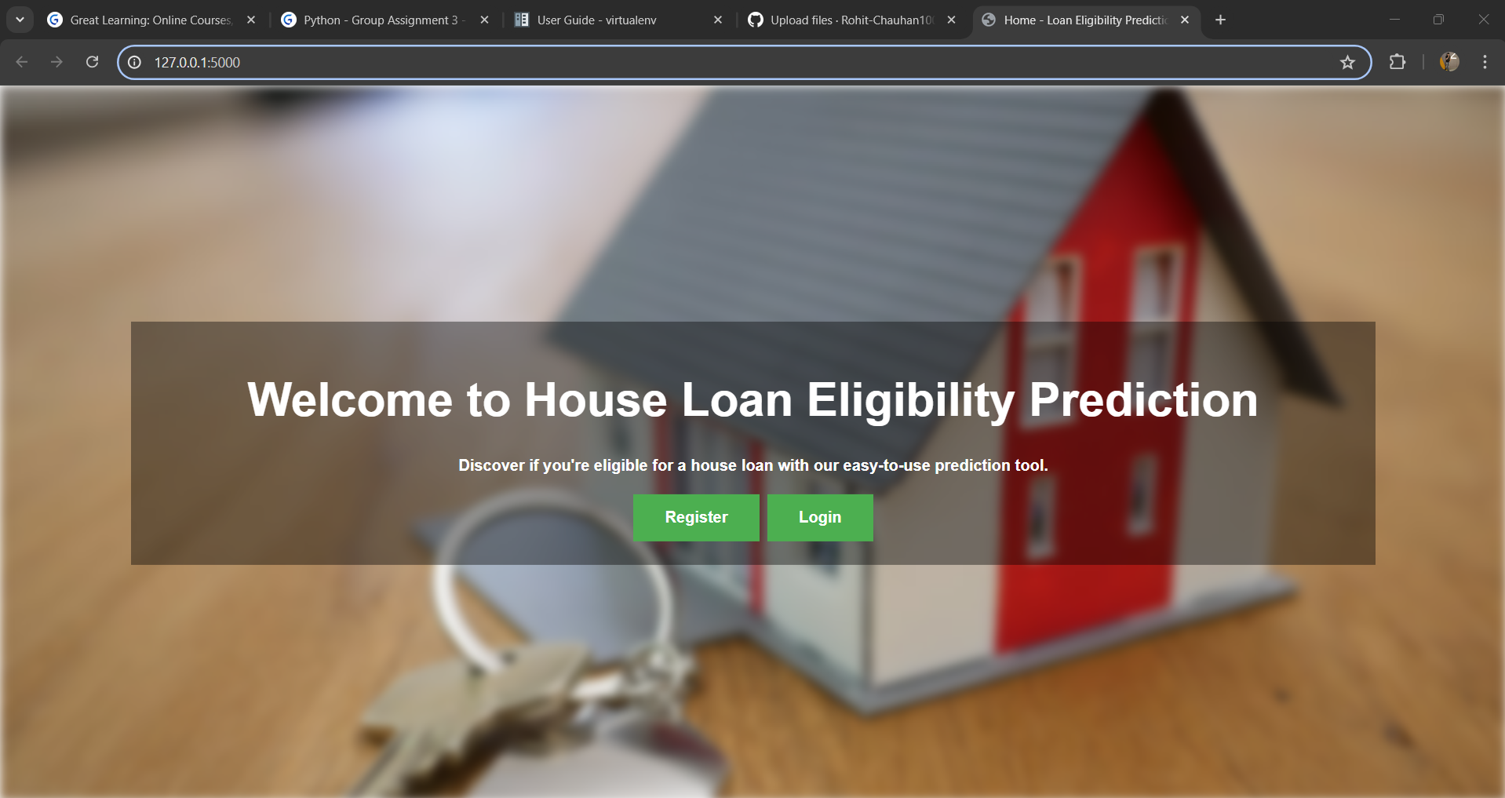
Home page

Slide 3
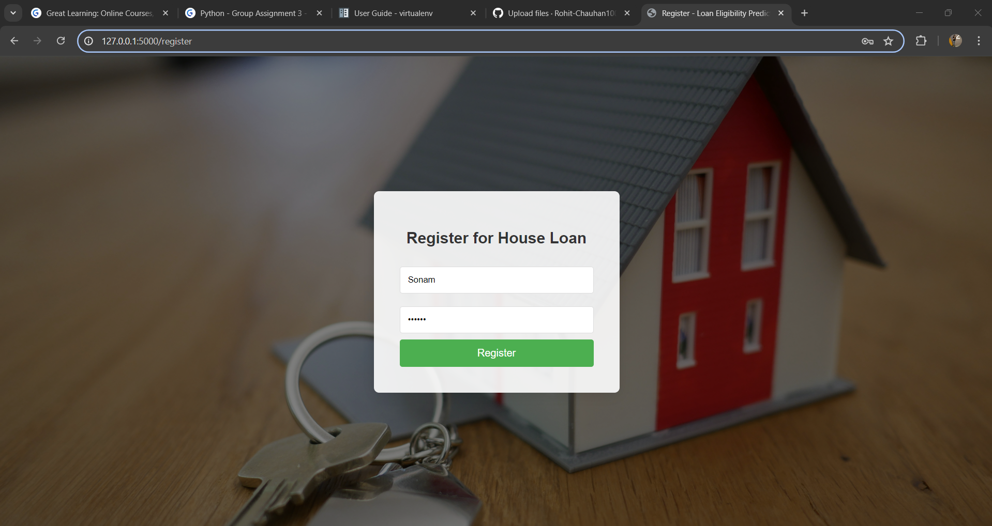
REGISTRATION pAGE

Slide 4
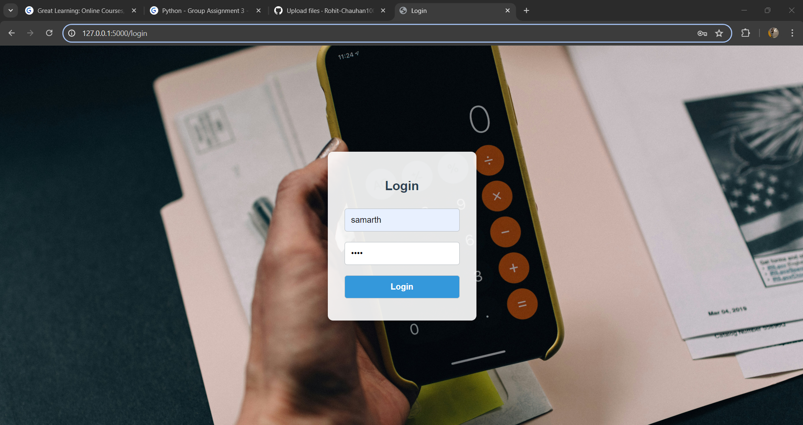
Login page

Slide 5
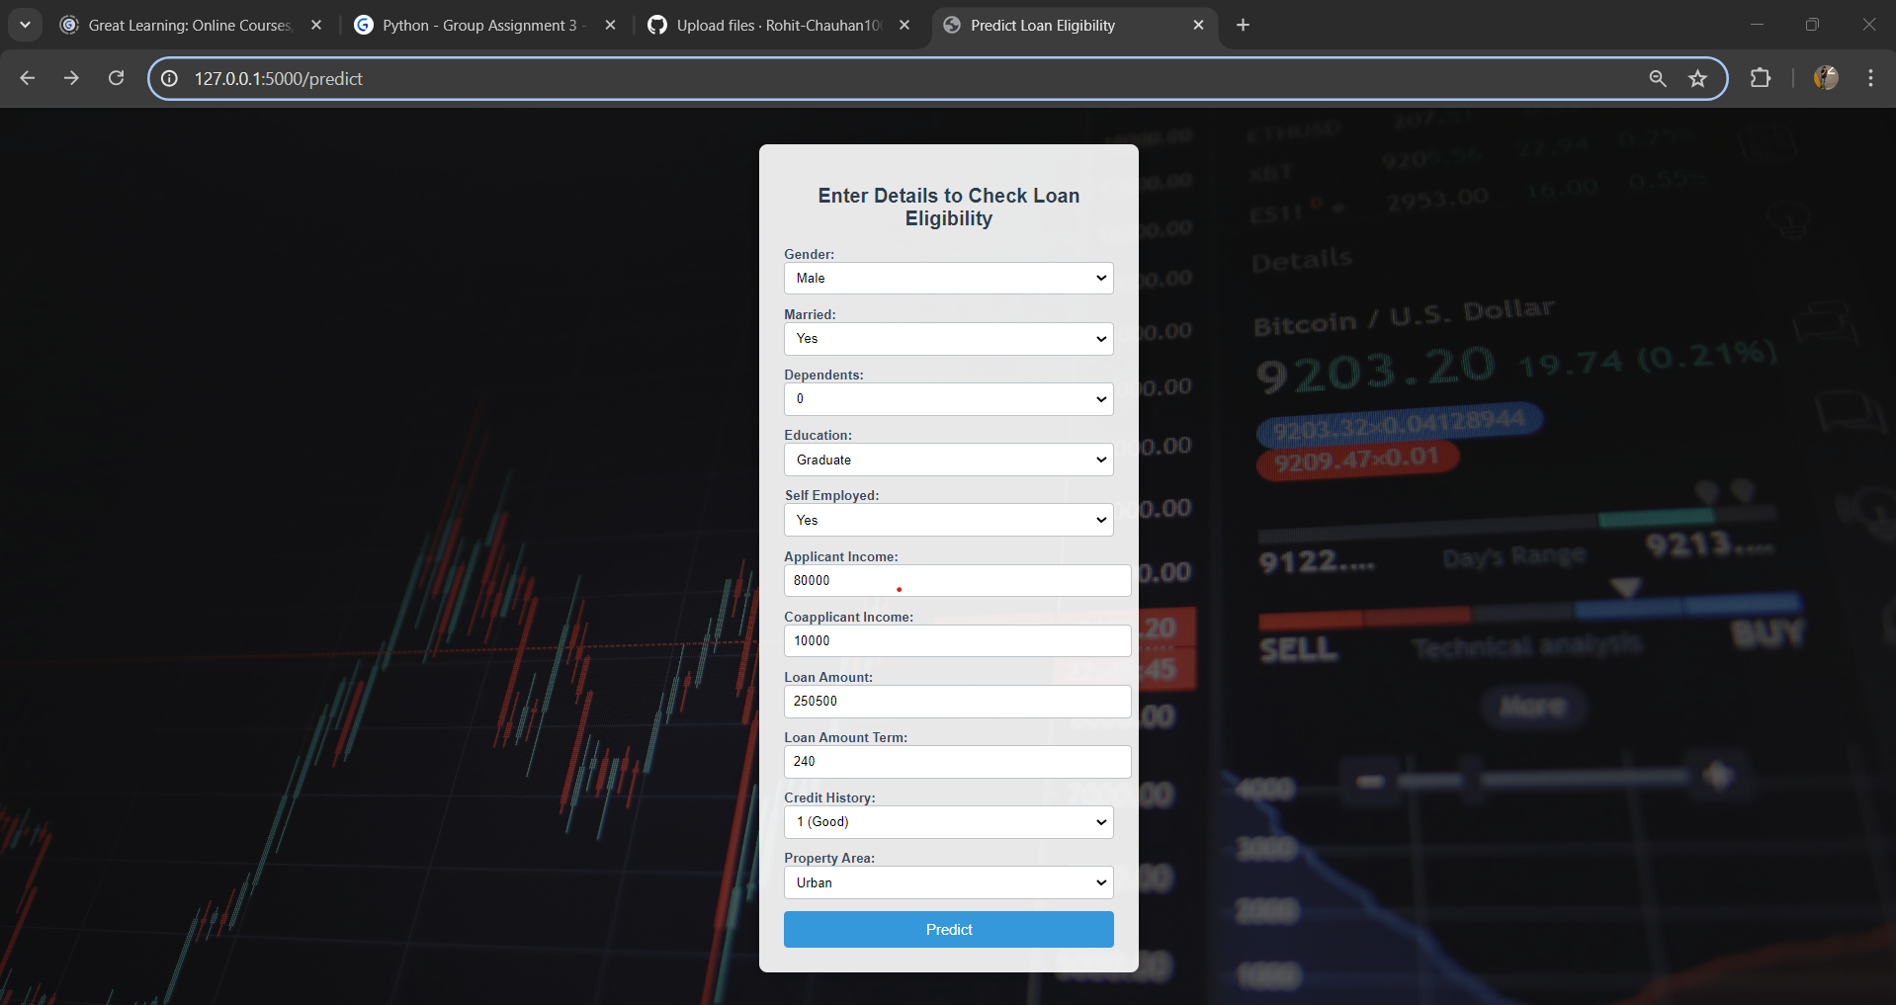
Prediction page

Slide 6
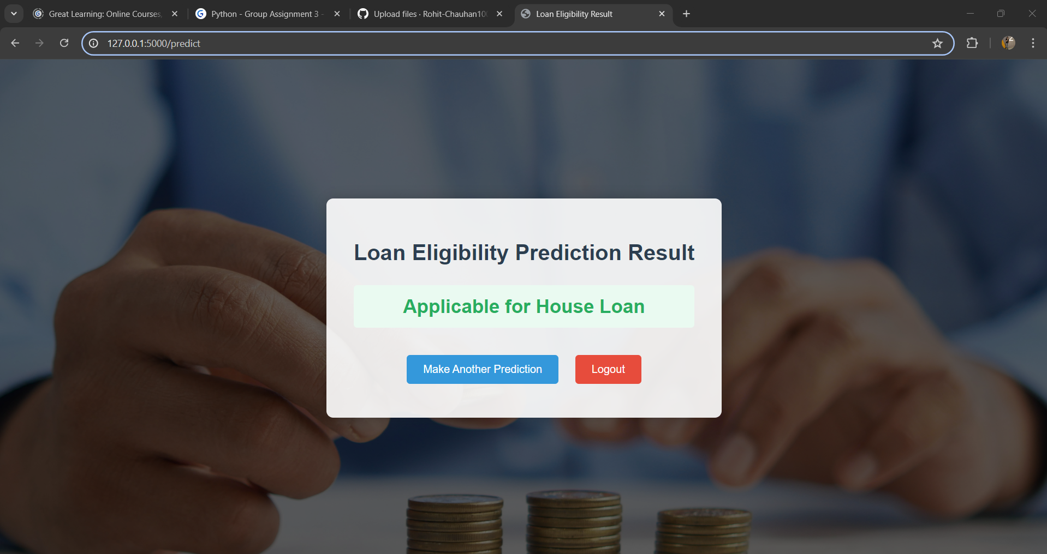
Result page

Slide 7
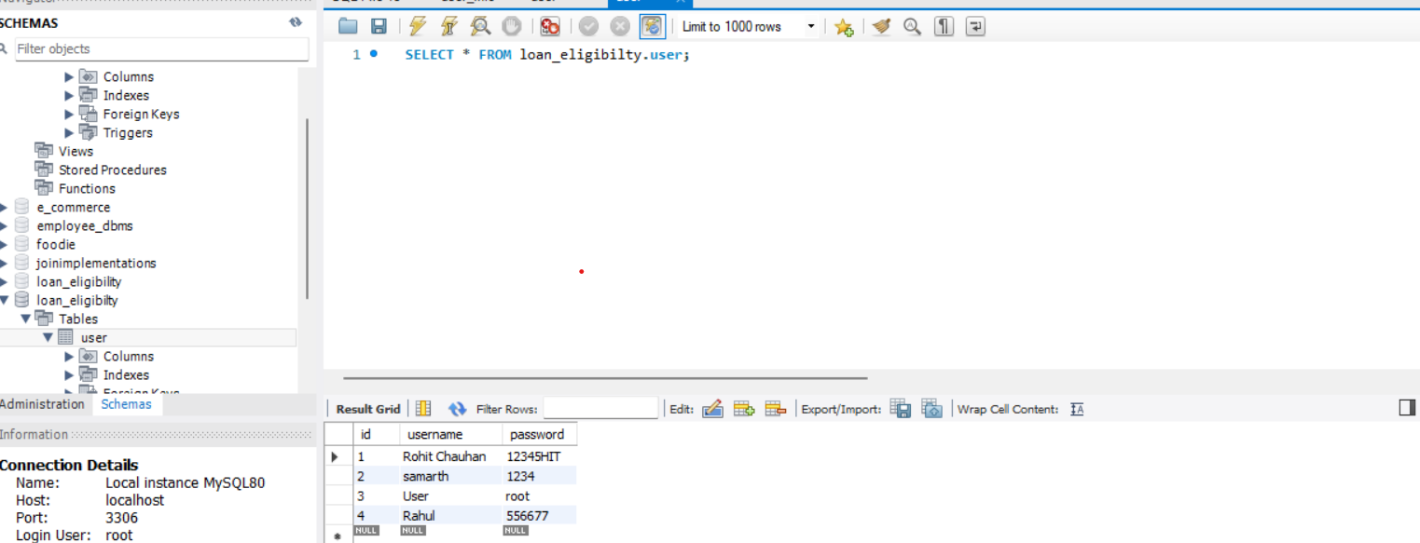
DAtabase

Slide 8
Thank you

